Slide 1
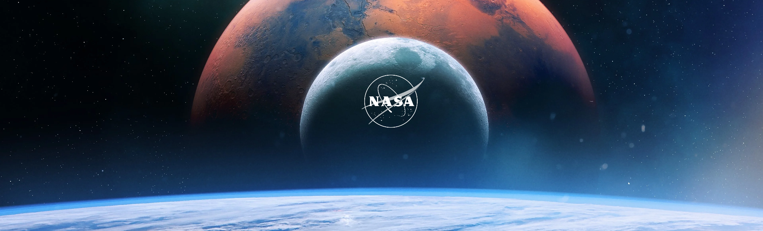
The Nasa Project
by G27

Slide 2

List of members
- Nguyễn Trịnh Bảo Trung - BI11-275 >> Group Leader
- Nguyễn Thành Trung - BI11-274 >> Figma Designer
- Phạm Đức Minh - BA11-073 >> Back-end Developer
- Vi Văn Chiến - BA11-014 >> Back-end Developer
- Đỗ Thành Đạt - BI9-065 >> UML Desinger
- Đỗ Minh Hoàng - BA11-045 >> UML Desinger

Slide 3
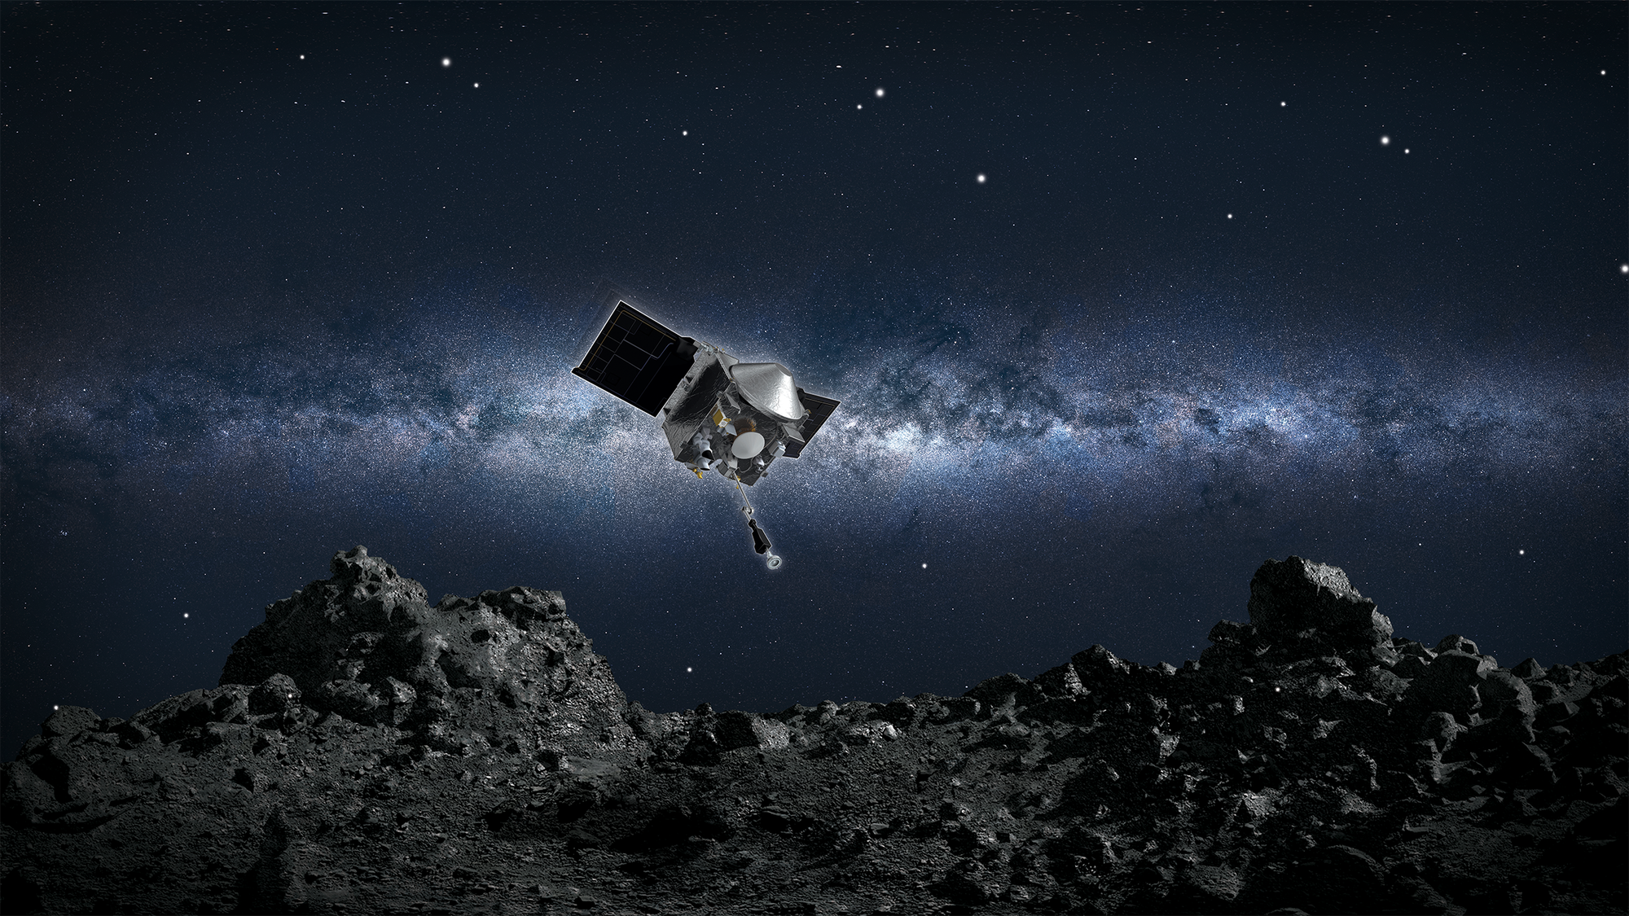
Table of content
Our vision
Development progress UML design Figma design Android app development
Our result today
What will we do next?

Slide 4
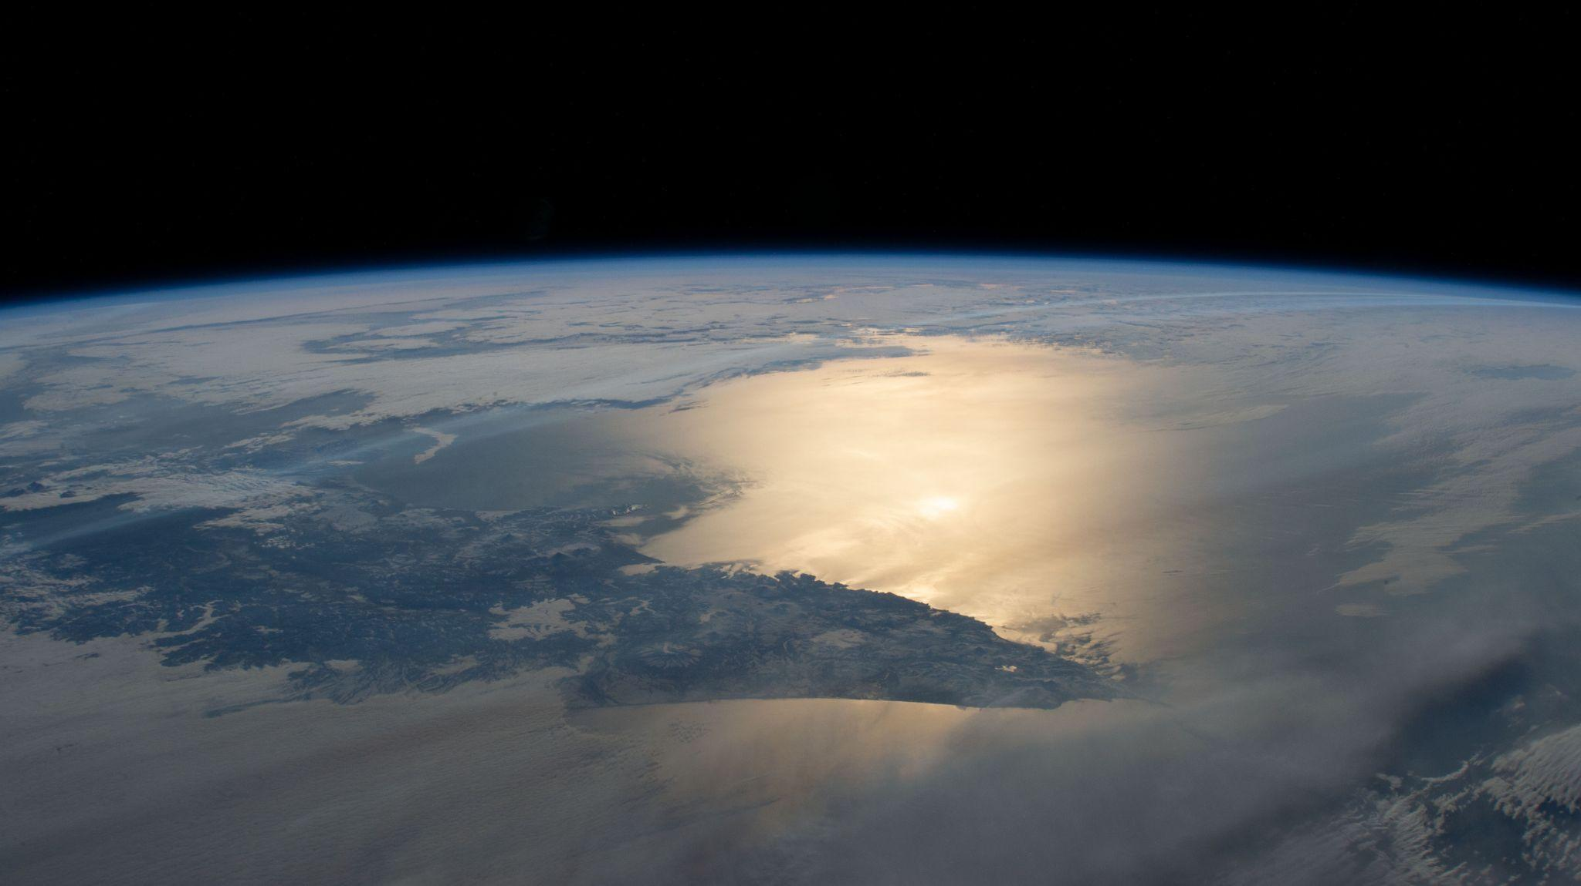
Our vision
A Mobile App for enthusiasts to access public content of Nasa, including: + Latest News articles + Enormous Image gallery + Ultra-High-Def Videos + Detailed Missions with its Schedules and even observing Sightings + 24/7 Livestream from the ISS

Slide 5
Our vision
Users are allowed to: + Search for their interest by Filtering categories or Look up for keywords + Save their progress for later + Download their loved content for offline reading
Users can contact us to resolve their problem or help us to upgrade the system

Slide 6
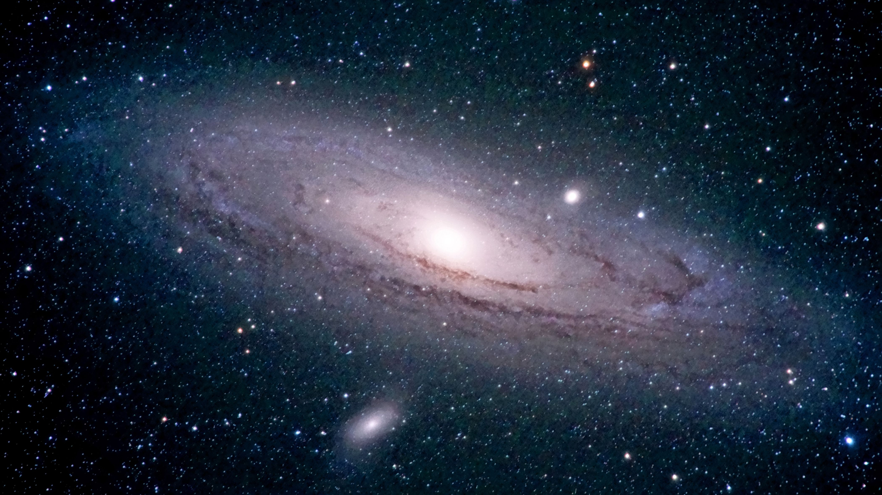
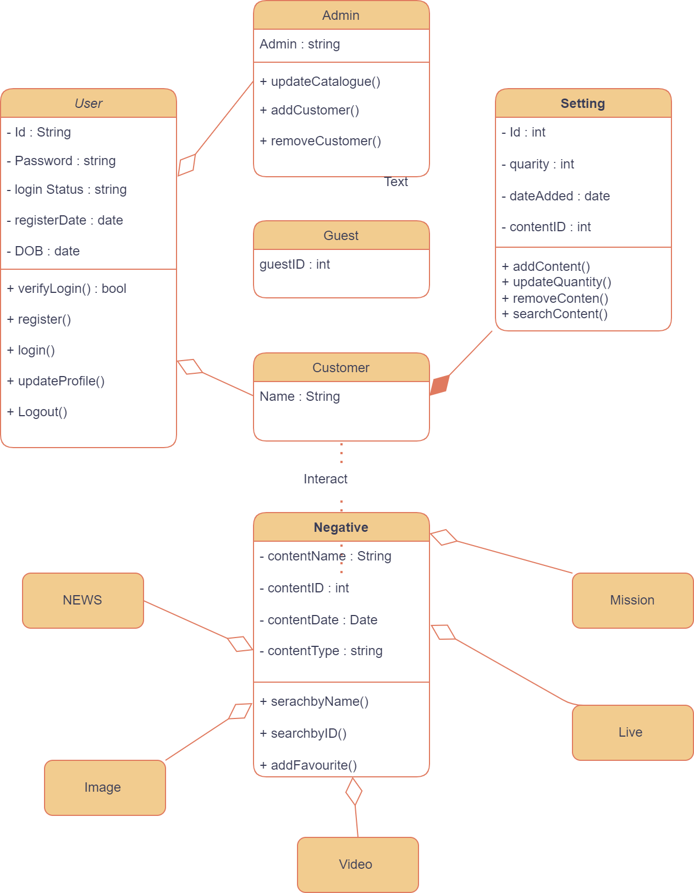
2. Development progress
UML Diagram
Class Diagram

Slide 7
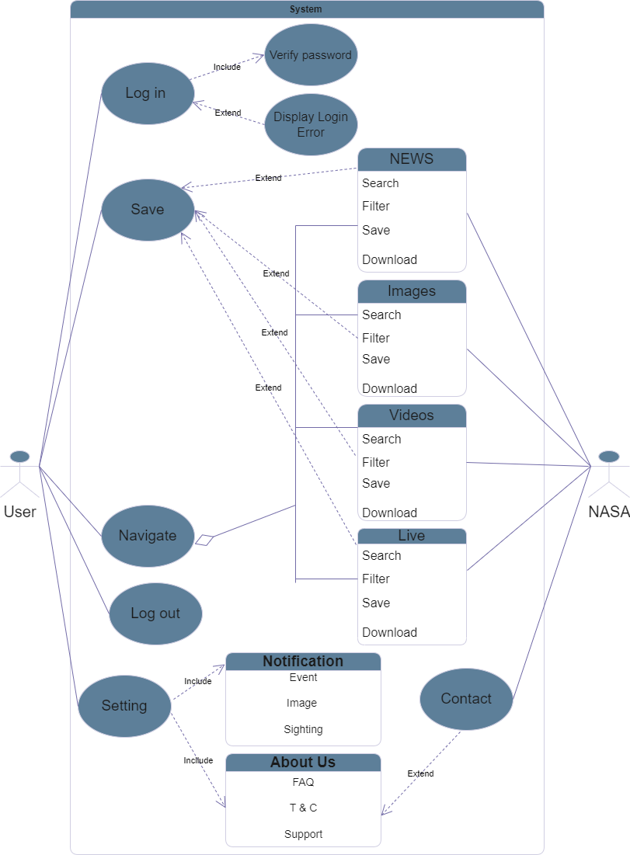
2. Development progress
UML Diagram
Use Case Diagram

Slide 8

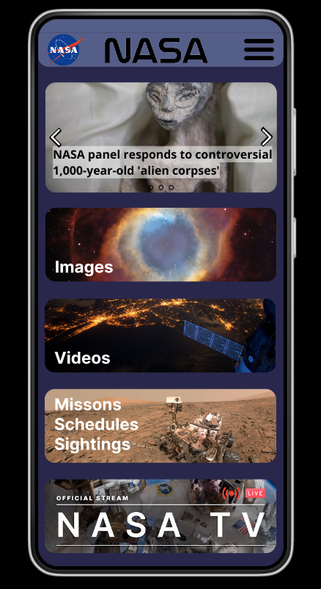
2. Development progress
B. Figma Design Home Page
News highlight
Images
Videos
Missions
Live feed
Expecting:
Live update for News articles and Live feed

Slide 9
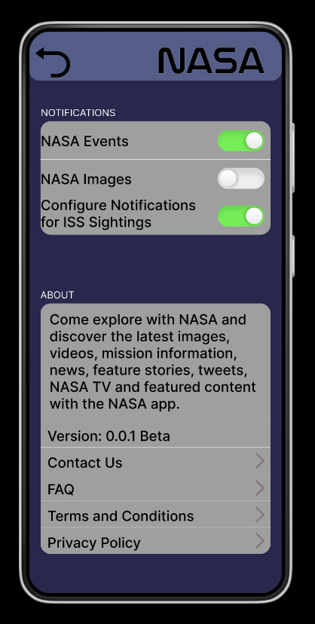
2. Development progress
B. Figma Design
Settings
Notifications
About us (NASA)
+ Connect to developers
+ Connect to Nasa
Expecting:
Floating window design

Slide 10
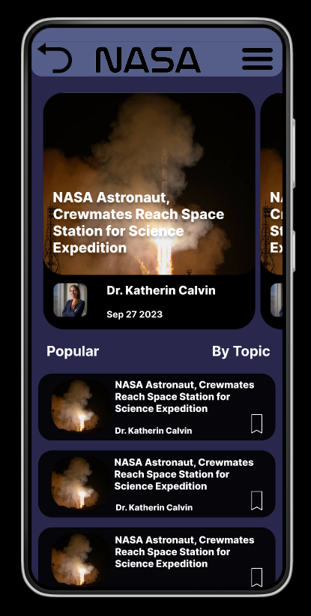
2. Development progress
B. Figma Design
News Page
Popular
By Topic
Expecting:
Search for a news article
Filter topic
Save an article for a later review
Download an article to read offline on their device

Slide 11
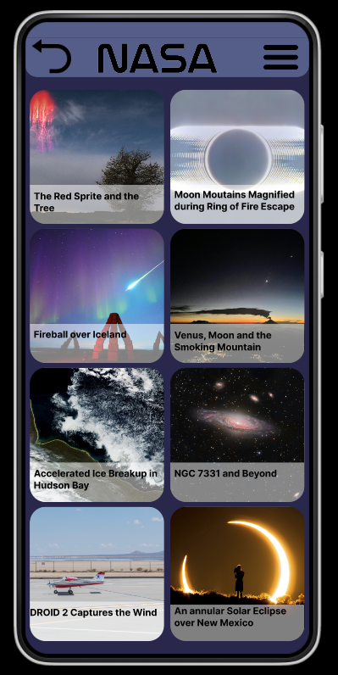
2. Development progress
B. Figma Design
Images Page
Highlighted Images
Thumbnail & Title
Expecting:
Browse by topics
Search for an image
Save images to user’s gallery
Download no copyright images to device
Set no copyright images as wallpaper

Slide 12
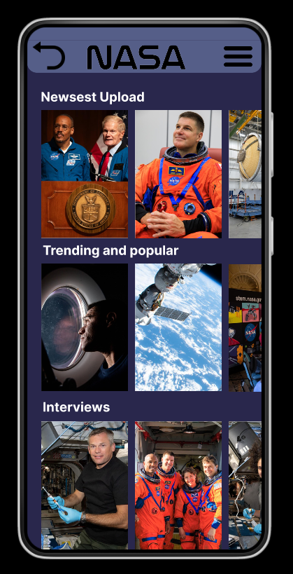
2. Development progress
B. Figma Design
Videos Page
Newest videos upload
Trending and popular globally
Records of interview with the crewmates
Expecting:
User can search for a particular video
Filter videos by topic
Download no copyright videos or records of interview
Save the favorite ones to watch later

Slide 13
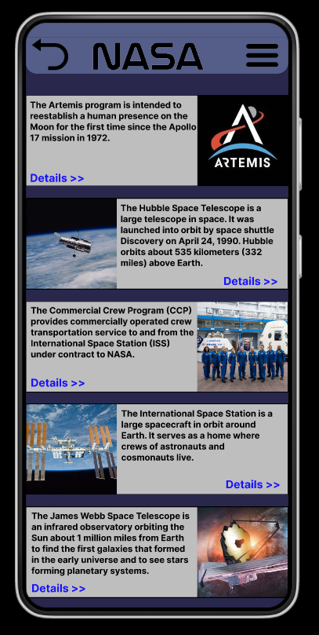
2. Development progress
B. Figma Design
Missions, Schedules and Sightings
Brief introduction of the mission
A thumbnail to illustrate
Watch in detail
Expecting:
Sync mission’s schedule with user’s calendar
Save a mission for getting up to date information

Slide 14
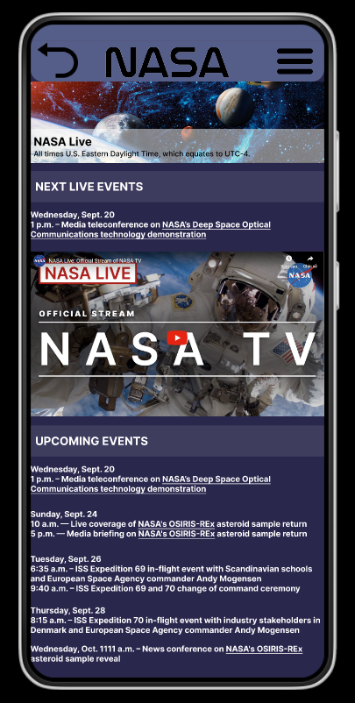
2. Development progress
B. Figma Design
Live feed Page
24/7 Livestream from the ISS
List of upcoming events
Expecting:
Live video can be played automatically
Browse other live videos
Sync favorite live events to user’s calendar

Slide 15
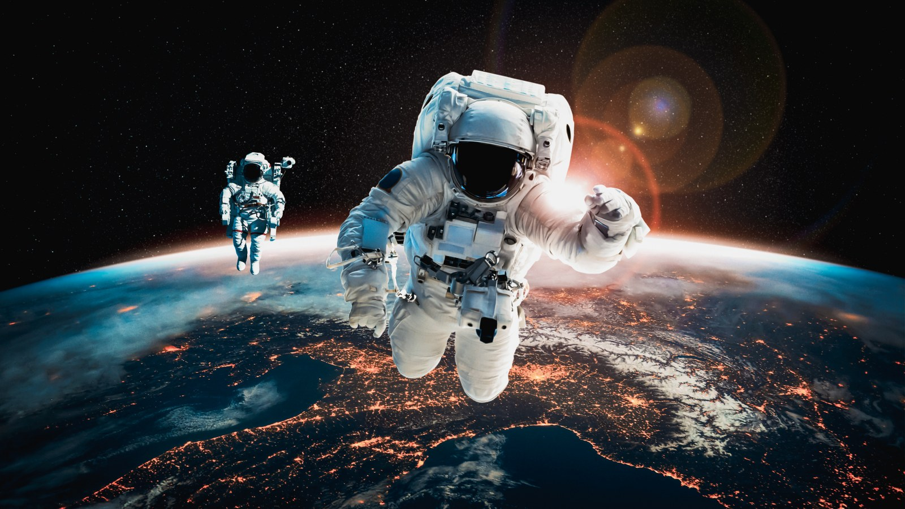
2. Development progress
C. Android App development

Slide 16

What will we do next?
Enhancing UX by personalizing user interest
Saving user data on cloud storage for multiple device synchronization
Adding Live photos, auto reading text, voice over
Embedding APIs to use network application and connect to servers

Slide 17
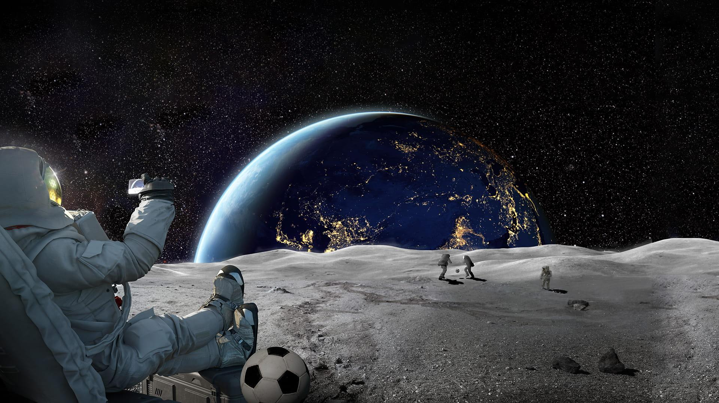
Stay tuned!
We will be right back with further updates

